Slide 1
SIES 630-01 Database Management Systems & Design
Final Project Draft
Project Topic: Cooking Recipe Portal
Project by: Mugdha Dixit

Slide 2
Introduction
Database which will have all recipe related data.
Implementation of basic registration and authentication.
User-friendly online recipe portal for food lovers.
Users can explore the portal and share their recipes.
Ratings column will save ratings and will use to decide ‘Recipe of the month’

Slide 3
Exploring
Why this topic :
Engaging topic.
Attracts large community of people/food lovers.
Beginners can learn, while experienced users can share their knowledge.
Database design :
Basic understanding in databases.
Visited some real time online portals.
Gathered recipes data.
Chose which fields and categories to add.

Slide 4
Building Database
Entity Identification:
Identified entities such as User, recipes category, and ratings for the database design.
Parent and child tables:
Under recipe category I added 4 subcategories in which you can add more categories further.
Relationship Definition:
Determined the relationships between entities, such as one-to-many and many-to-many relationships, and defined them in the database design.

Slide 5
5 Topic from class
included in this project
Database Design
Use of Parent – Child data tables.
Logical and Relational diagram in data modeler
CRUD Operations
SQL Queries – DDL, DML, DDL, DQL.

Slide 6
Database Design
User
User Id - PK
User Name
Email
Password
Ratings
Rating Id - PK
Recipe Id – FK
User Id – FK
Rating value
Recipe category
Category Id - PK
Category Name
Recipe of the Month
RM id - PK
Month Name
Rating Id

Slide 7
Use of Parent – Child data tables.
Recipe category
Category Id - PK
Category Name
Vegetarian
Non - Vegetarian
Vegan
Desserts

Slide 8
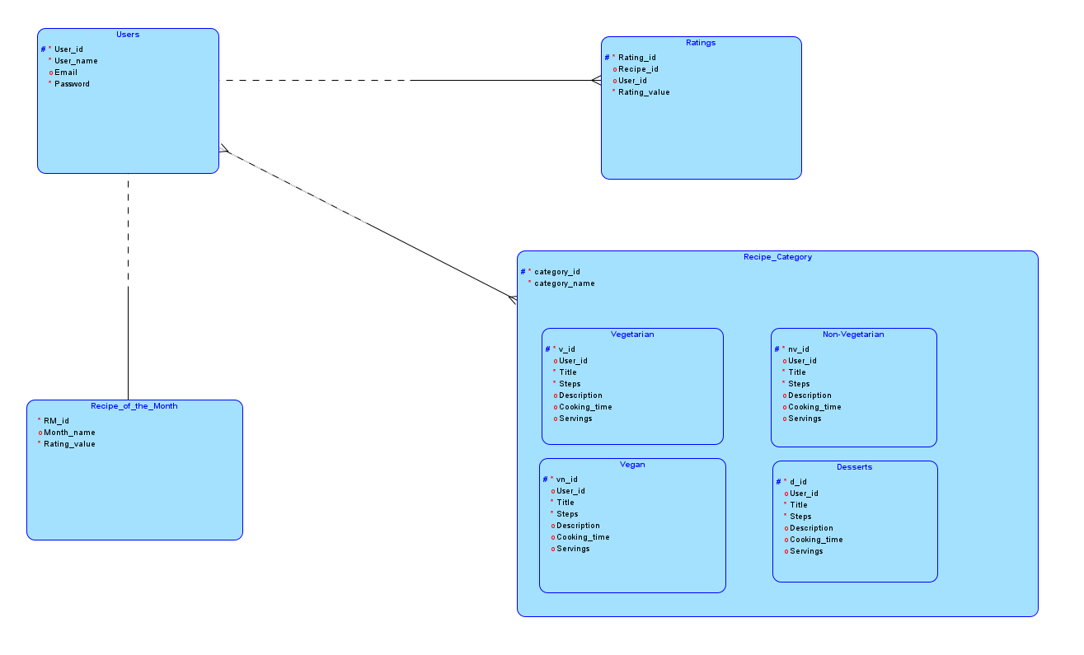
Logical diagram in data modeler

Slide 9
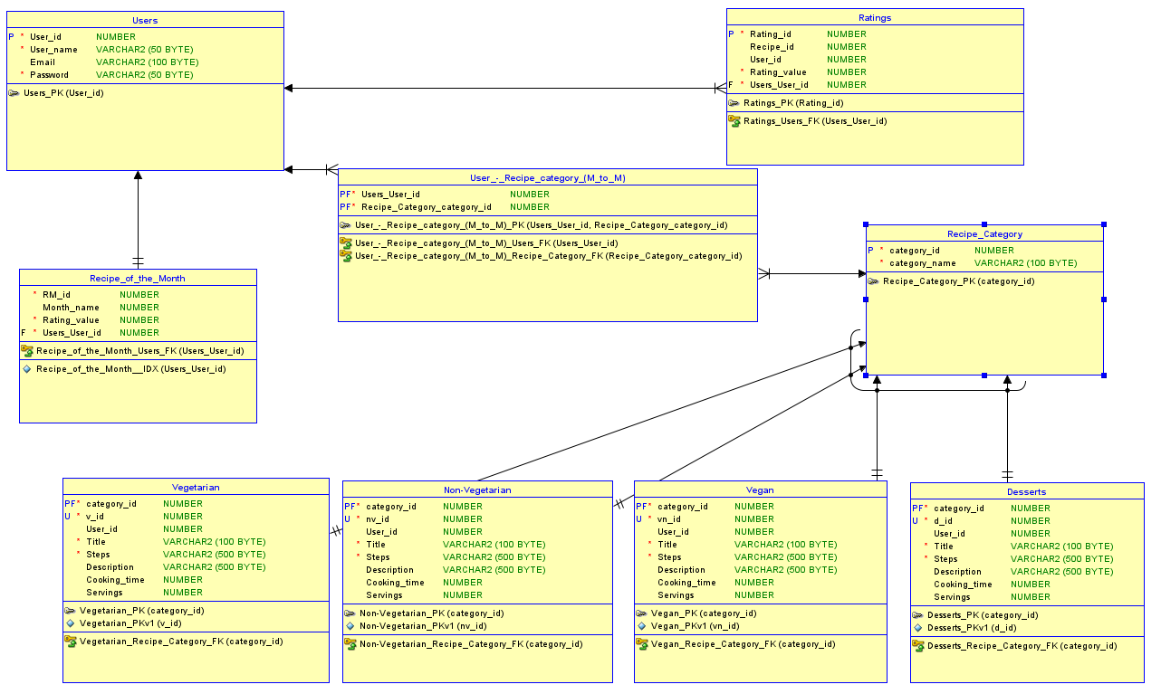
Relational diagram in data modeler

Slide 10
CRUD Operations
create table users(
user_id int primary key,
user_name varchar(50) not null,
email varchar(100) unique not null,
password varchar(50) not null);
select * from users;
update ratings set rating_value = 5 where user_id = 36;
delete from users where user_id = 16;

Slide 11


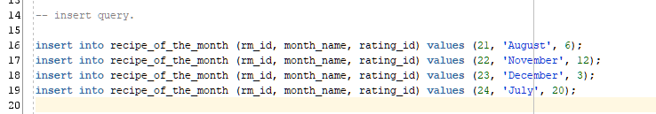
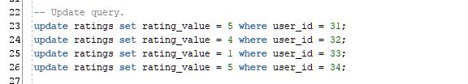
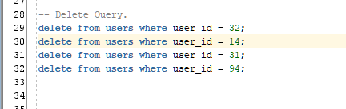
SQL Queries – DDL, DML, DDL, DQL.

Slide 12
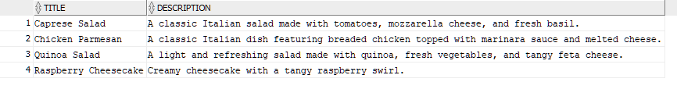
Advanced SQL Queries
-- shows all the recipes from all four categories which has cheese in its description.
select title, description
from vegetarian
where description like '%cheese%'
union
select title, description
from nonvegetarian
where description like '%cheese%'
union
select title, description
from vegan
where description like '%cheese%'
union
select title, description
from desserts
where description like '%cheese%';

Slide 13
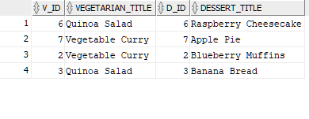
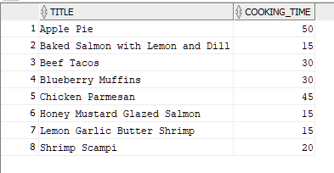
-- Users who have added recipes in category veg as well as desserts.
select v.v_id, v.title as vegetarian_title, d.d_id, d.title as dessert_title
from vegetarian v
inner join desserts d on v.v_id = d.d_id;
-- shows all the recipes from table non-vegetarian and desserts which has cooking time less than 60 min
select title, cooking_time from nonvegetarian where cooking_time < 60
union
select title, cooking_time from desserts where cooking_time < 60;

Slide 14
Thank You!!!

